Slide 1
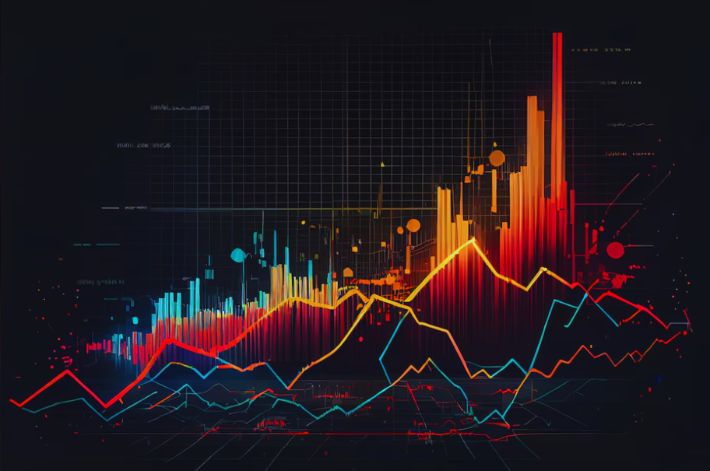
Fitness Data Analysis

Slide 2
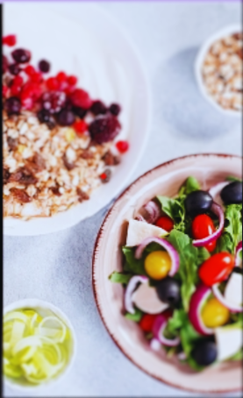

Contents
Terminology
Data Explanation
Code Explanation
Conclusion
Notes:
table of content
terminologies
BMR
BMI
CALORIE INTAKE
ACTIVITY LEVEL

Slide 3

Terminology
BMI
Weight by height.
BMR
Number of calories burnt by the body at rest.
Activity Level
Physical activity done in a day.
Calorie Intake
Total amount of enery gained from food.

Slide 4
Data
The data collected for the analysis is from Kaggle .
It consists of 8 columns and 80 rows.
It consists of data of people between the age group of 15 to 22 years.
Below are the names of the columns:

Slide 5
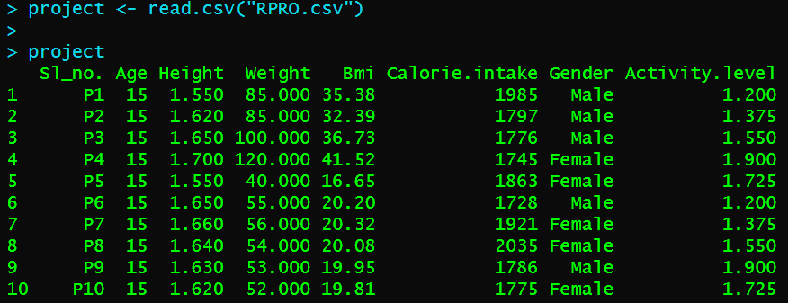
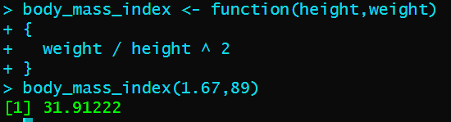
Input
Output
project <- read.csv("RPRO.csv")
project
body_mass_index <- function(height,weight)
{
weight / height ^ 2
}
body_mass_index(1.67,89)

Slide 6
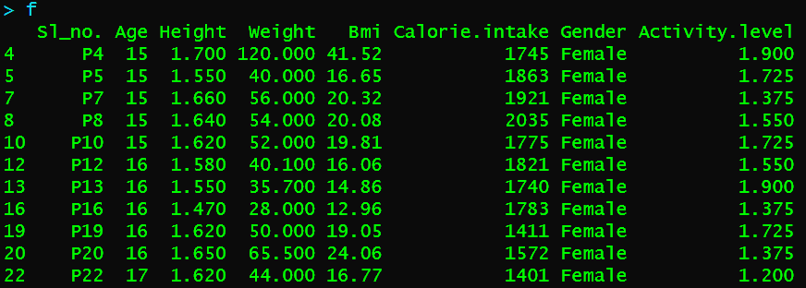
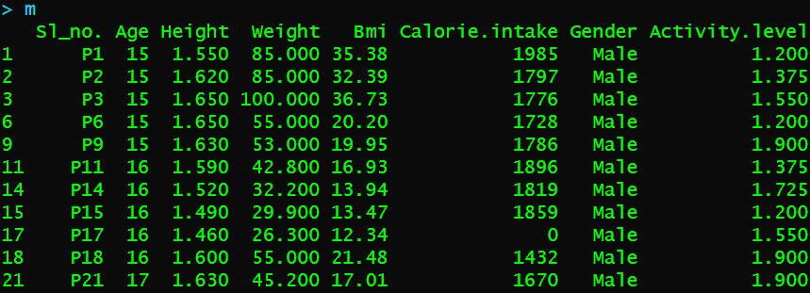
Input
Output
f <- project[project$Gender == "Female", ]
m <- project[project$Gender == "Male", ]
f
m

Slide 7
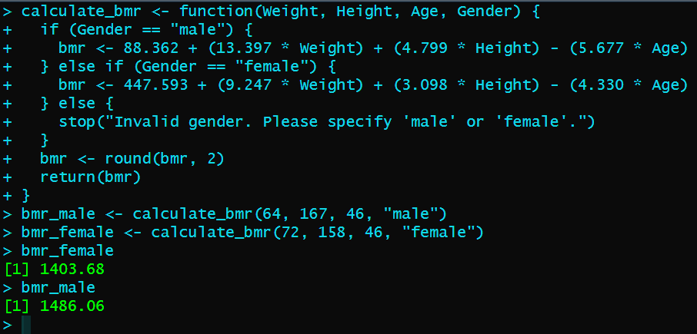
Input
Output
calculate_bmr <- function(Weight, Height, Age, Gender) {
# Check Gender
if (Gender == "male") {
bmr <- 88.362 + (13.397 * Weight) + (4.799 * Height) - (5.677 * Age)
} else if (Gender == "female") {
bmr <- 447.593 + (9.247 * Weight) + (3.098 * Height) - (4.330 * Age)
} else {
stop("Invalid gender. Please specify 'male' or 'female'.")
}
bmr <- round(bmr, 2) return(bmr)
}
bmr_male <- calculate_bmr(64, 167, 46, "male")
bmr_female <- calculate_bmr(72, 158, 46, "female")
bmr_female
bmr_male

Slide 8
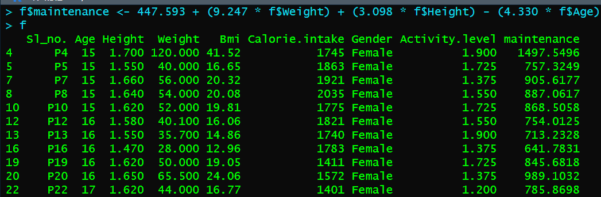
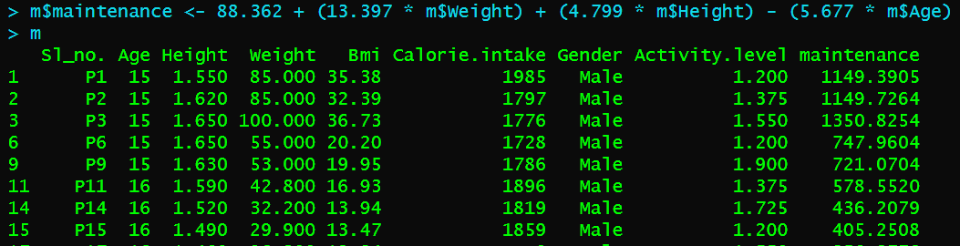
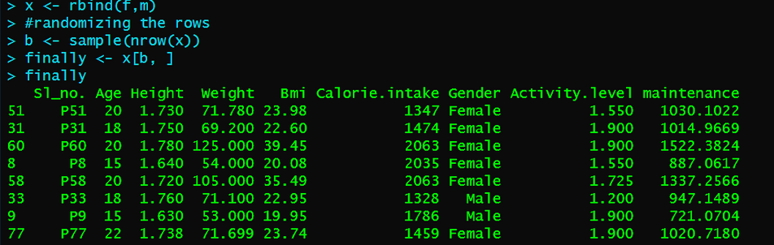
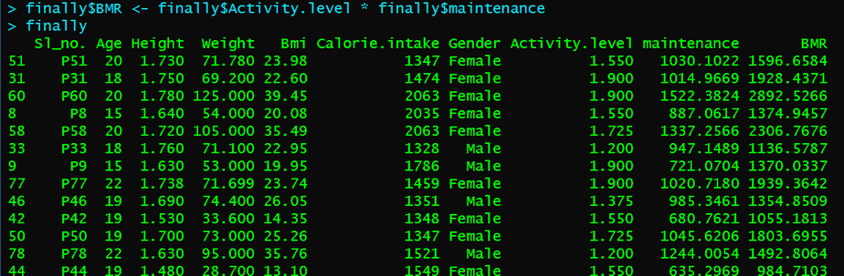
Input
Output
f$maintenance <- 447.593 + (9.247 * f$Weight) + (3.098 * f$Height) - (4.330 * f$Age)
f
m$maintenance <- 88.362 + (13.397 * m$Weight) + (4.799 * m$Height) - (5.677 * m$Age)
m
x <- rbind(f,m)
b <- sample(nrow(x))
finally <- x[b, ]
finally
finally$BMR <- finally$Activity.level * finally$maintenance
finally

Slide 9
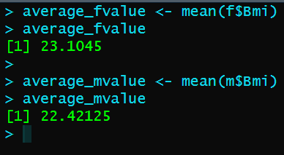
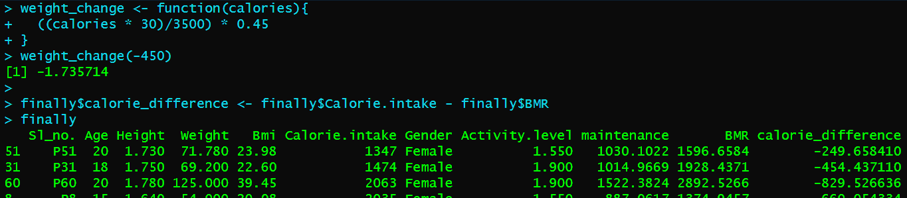
Input
Output
install.packages("dplyr")
library(dplyr)
average_fvalue <- mean(f$Bmi)
average_fvalue
average_mvalue <- mean(m$Bmi)
average_mvalue
weight_change <- function(calories){
((calories * 30)/3500) * 0.45
}
weight_change(-450)
finally$calorie_difference <- finally$Calorie.intake - finally$BMR
finally$weight_difference <- ((finally$calorie_difference * 30)/3500) * 0.45
finally

Slide 10
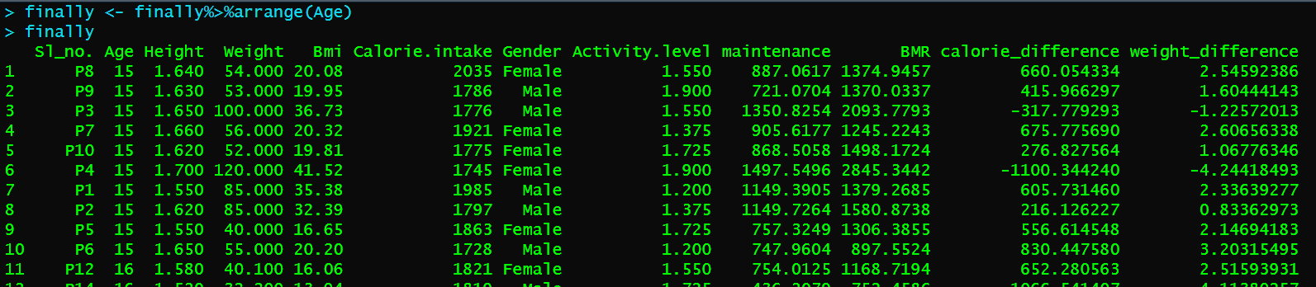
Input
Output
finally <- finally%>%arrange(Age)
finally

Slide 11
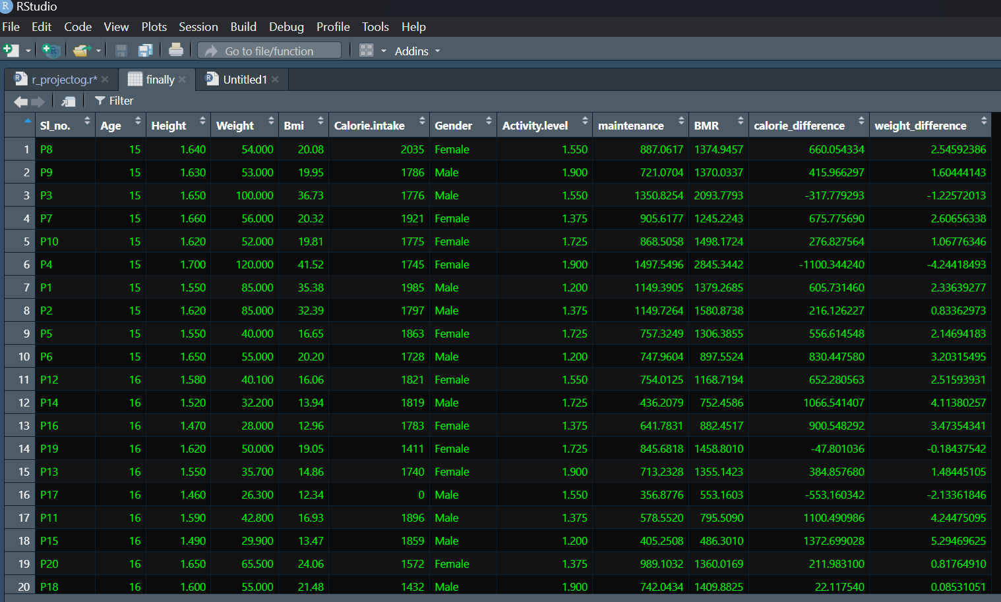
Processed data:

Slide 12
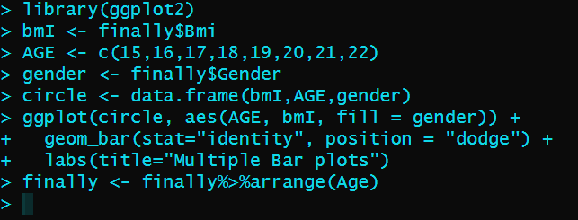
Input
Output
install.packages("ggplot2")
library("ggplot2")
library(ggplot2)
bmI <- finally$Bmi
AGE <- c(15,16,17,18,19,20,21,22)
gender <- finally$Gender
circle <- data.frame(bmI,AGE,gender)
ggplot(circle, aes(AGE, bmI, fill = gender)) +
geom_bar(stat="identity", position = "dodge") +
labs(title="Multiple Bar plots")

Slide 13
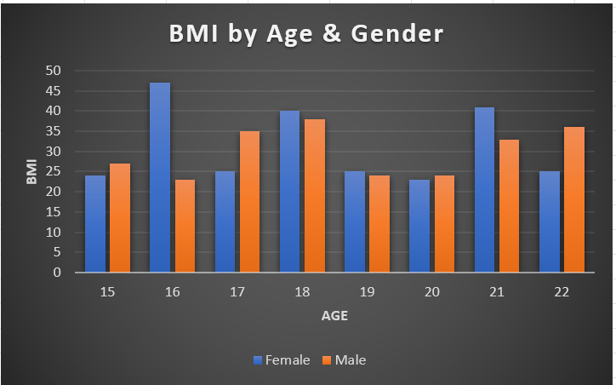

Slide 14
Conclusion
Data Organization
Data Preparation
Data Manipulation
Data Analysis
Data Visualization

